Slide 1
BUPERS-3
Promotion Planning
HR Brown Bag
December 2022
CDR Shaina Hogan
HR (1200) Officer Community Manager
BUPERS-314B
LCDR Dustin Hoskins
HR (1205/1207) Officer Community Manager
BUPERS-351

Slide 2
Overview
Promotion fundamentals
  Differences between AC and RC
HR Community Overview
Questions and Answers
Notes:
Main point/objective is emphasize the different roles Community Management how that differs from Detailing as well as how we work together.

Slide 3
Promotion Planning Fundamentals
Active Component
Opportunity: the in-zone “possibility” of selection
Flow Point: Average years of service when an officer is promoted (paid) to the next grade
Grade | LAW (Title 10 §623) OPP FLOW | DoD (DODINST 1320.13) OPP FLOW | Navy (SECNAVINST 1420.1B) OPP FLOW
CAPT CDR LCDR | “Relatively similar opportunity for promotion in each of the next five years” | 50% * 21-23 yrs 70% * 15-17 yrs 80% * 9-11 yrs *(+/- 10 percent) | 40-60% 21-23 yrs 60-80% 15-17 yrs 70-90% 9-11 yrs
NOTE: Must be at least 3 years TIG at time of board convening
Higher opportunity results in a smaller zone and increases flow point
Lower opportunity results in a larger zone and decreases flow point
Notes:
3
3
3
Purpose is based in law, DOPMA, US Code, DoD Inst. To keep all the services looking relatively similar.
Overall rule, think when you adjust the “opportunity” for the board, you aren’t adjusting the number of selections those are driven by projected vacancies, you are impacting zone size and flow point which applies to the IN ZONE population only.

Slide 4
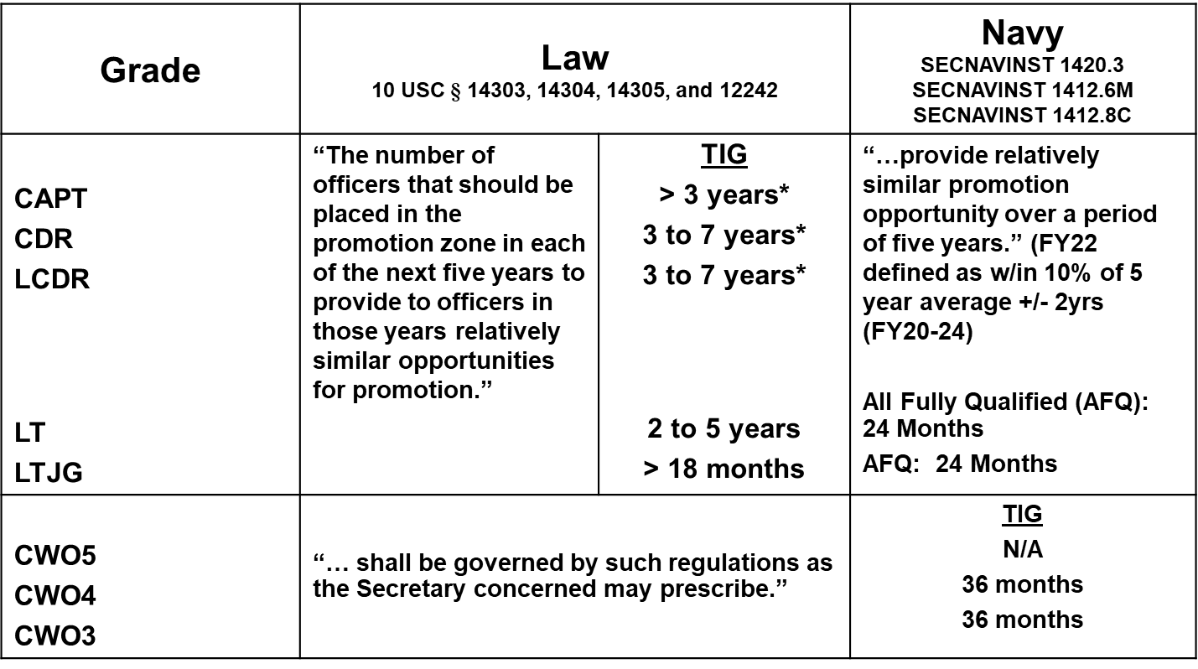
Promotion Planning Fundamentals
Reserve Component
*Must be at least 3 years TIG at time of board. Maximum TIG applies to promotion date
Notes:
4
4
4
Key differences from AC:
No flow point
- Also have some differences in continuation for CAPT, CDR

Slide 5
Below Zone (BZ) Selections
Grade | Law 10 USC § 14303, 14307 and 12242 |  | Navy SECNAVINST 1420.3 SECNAVINST 1412.8C (LDO/CWO)
CAPT CDR LCDR | BZ selections cannot exceed 10% of the total number of authorized selections; 15% with SECDEF approval One BZ selection is authorized when 10% of the in-zone-eligible officers is less than one BZ selections may not increase the total number of authorized selections | TIG > 3 years * * Secretary may waive to ensure two below zone looks | “Below-zone eligibility, if prescribed, will be indicated by the name, precedence number, and date of rank of the designated junior officer eligible…”
CWO5 CWO4 | “… shall be governed by such regulations as the Secretary concerned may prescribe.” |  | Guidance disclosed in FY Board Convening order
Notes:
This slide summarizes the legal and policy restrictions on promotion planning. Title 10 requires a relatively similar opportunity across the five planning years, and TIG restrictions for LCDR and CDR. Although Title 10 allows TIG to go as low as 3 years, the plan was developed to ensure average TIG in any competitive category remains above 5 years to ensure sufficient maturity in current rank.
SECNAV policy also requires the plan to provide relatively similar promotion opportunity over a period of 5 years. This has been defined as maintaining within 10% of the rolling average of the five year period centered on the current planning year. For this year, it is FY19 to FY23.

Slide 6
Definitions
Flow point: Average years of service when a due course officer is promoted to the next grade (calculated based on IZ population)
Opportunity Rate (OR): Planning factor determining the size of the Zone to produce the desired number of selections (Publicized in Convening Order)
Selection Rate: Percentage of all officers selected for promotion (Publicized post-board for AZ, IZ, BZ, and Overall). Overall Selection Rate = Opportunity Rate if there are not any Above Zone Not Previously Considered officers
Effective Selection Rate (ESR): Percentage of officers selected relative to all eligible officers (Not publicized - Actual quality cut percentage for all officers considered)
  Max below zone - 10% of selections (statutory limit)
  No above zone limits (by law or policy)
  All officers on the Active Duty List at time of the board are considered
  Desired Selections
  Opportunity Rate
= # of IZ Officers
  Selections (AZ+IZ+BZ)
  Total Officers In Zone
= Selection Rate
  Selections (AZ+IZ+(Max 10% BZ)
  Total Eligible Officers (AZ+IZ)
= Effective Selection Rate
Notes:
Flowpoint – average years and months of service when a due course officer is promoted, not frocked
Calculated for you in the Officer Promotion Calculator Model (OPCM) … otherwise known as “Flowpoint Calculator”
You’ll have to take that data from OPCM and plug it in manually to the Green Sheets, which will be covered more in depth in later slides.
Note difference between “Opportunity” and “Selection Rate” the terms are often confused in communications. Opportunity is something you as the OCM and me as the Promotion Planner use to adjust the zone size and therefore flowpoint. Selection rate is determined after the board completes and the actual selections are publicized.
For example: If 100 officers are in the zone, and there are 10 AZ plus 80 IZ plus 5 BZ, then Selection Rate is 95% = (10+80+5)/100
We do not count the junior eligibles in the numerator, but do in the denominator
Requirements are the ROPA, Vacancies are things like retirements, deaths, promotions, lateral transfers out; and the legal limit is DOPMA table that limits the officer corps size relative to the size of the Enlisted population, and further limits the population by paygrade in the control grades.
You won’t have to worry about figuring for any DOPMA limits … the inventory data that is published by N10 already takes this into consideration.

Slide 7
Promotion Planning Products
Community Values and Career Progression Brief
Convening Order Language
  Critical Competency Skills by Paygrade
Promotion Plan (5 yr plan - # selects, Opportunity Rate, Eligibles)
These products depend on:
  Final Inventory (End Strength)
  Current OPA/ROPA
  Loss Projections
PROMOTION PLANS FILL PAYGRADE VACANCIES FOR NEXT FISCAL YEAR

Slide 8
Promotion Planning Factors
Promotion plans completed by OCMs in Oct of prior FY.
For in-year retirements, typically use known retirements averaged together with three year average loss rate.
For out year planned retirements, typically use 3-10 year average loss rates.
Flow point is determined by taking average YCS corresponding to 1 Sep of FY officers are IZ for promotion.
TIG is determined by taking average of in-zone officer’s TIG to 1 Sep of FY officers are IZ for promotion.

Slide 9
Promotion Planning Formulas
For Each Pay Grade (LCDR thru CAPT):
  Promotions_{FY+1} = OPA - (Begin Strength + Gains + Promotions In_{FY} - Promotions Out_{FY} - Losses)
  Assumptions: Grade gains and grade losses are generally derived from average historical behavior
  Knowns: OPA and grade begin strength are known (provided by OPNAV N1)
Examples of grade gains include lateral transfers or permanent reserve recalls at that grade
Examples of grade losses include retirements or resignations
When promotion planning, work CAPT first. Once CAPT is complete, move on to CDR. Once CDR is complete, move on to LCDR.

Slide 10
Community Management Strength Planning
Community End Strength Equation (All Paygrades)
ES = BS + Gains – Losses
Paygrade End Strength Equation (Individual Paygrades)
ES = BS + Gains + Promotions In – Promotions Out – Losses
Promotion Planning Equation
Promotions_{FY+1} = OPA – BS - Gains - Promotions In_{FY} + Promotions Out_{FY} + Losses
ES – End Strength
BS – Begin Strength
Sometimes substitute OPA for ES
Equations drive most Community Management planning.
Notes:
There is some simple math in community management, differs from Strength planning, in that you are not just planning in the aggregate, you are managing by community, by paygrade
ES = Inventory on 30 September
-Must also account for Promotions in/Out by paygrade (i.e. think bathtub).

Slide 11
CDR Promotion Planning Example
Vacancies = OPA – Begin Strength – Gains – Promotions In + Promotions Out + Losses
The known vacancies will determine the promotions from LCDR (Gains)
Gains
(INDEF Recall, Retire-Retain)
End Strength = Begin Strength + promotions in + gains - losses - pending promotions out
GOAL: Match Inventory to OPA across FYDP with Promotion Plan
Promotions In from LCDR
Begin Strength: CDRs on inventory at end of FY
OPA/ROPA: Released in early October
CDR
Separation
Promotions Out to CAPT
Retirement
Losses and Historical Loss Rates
CAPT Promotion Guidelines:
Opportunity: 50 ±10%
Flow point: 22 ± 1 YCS (ave across IZ population)
Notes:
Here is an example for a paygrade. If this is overkill can skip over slide.
Can use examples from our community. We have models and data to predict historical rates of loss and promotion. Use of Indef recall, and have input on retire retain approval.
Must stay within guidelines and manage flowpoint. Which we will talk about later….

Slide 12
Promotion Zone Factors:
Summary
Number of Vacancies
  OPA (increases/decreases)
  Losses (resigs/retirements/promotions out/CIP/other)
  Gains (promotions in/lateral transfers in/INDEF Recall/CIP returns)
SECNAV guidelines
  Flowpoint (AC only) & TIG
  Opportunity
TIG
  Junior IZ must have at least 3 years TIG at time of the board
Other Factors
  BZ selections
Remember – it is just planning, it is not personal!
Notes:
So in summary what drives/factors in promotions….

Slide 13
Promotion Green Sheet
Green cells are filled in by OCM to produce plan
Notes:
So in summary what drives/factors in promotions….

Slide 14
Backup

Slide 15
How Do I Know if I am in Zone?
Step 1: Review Annual Promotion Zone Message
  Released NLT 30 days prior to convening of O6 Line Board
  Separate messages for AC and RC
Step 2: Download Naval Register officer list via BOL
  Select Officer type (Active, FTS, Reserve), current pay grade, and competitive category (HR)
  Click Search, select “Export to Excel”, save as an Excel Workbook and sort by lineal/precedence number
Step 3: Mark the Zone (Senior IZ, Junior IZ, Junior Eligible) & compare lineal/precedence numbers
  IZ: lineal number is < Junior IZ
  Above Zone Not Previously Considered: Lineal number > Senior IZ and no previous IZ promotion considerations/looks
  BZ (AC only): lineal number is >Junior IZ, < Junior Eligible
  Ineligible: lineal number is > Junior IZ (RC) / Junior Eligible (AC)
Refer to HR Beacon 2017-09, August 2017
Notes:
Walk them through how to determine if they are in zone. Lineal # also on your ODC. Can look at draft promotion zone projections on HR OCM website.

Slide 16
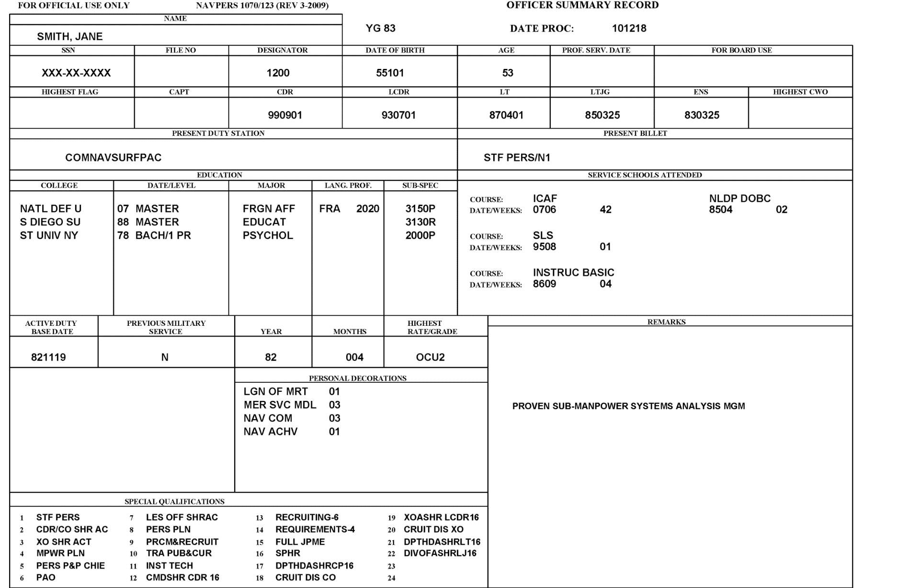

Officer Summary Record (OSR)
NOTE: Remarks are removed from OSR for statutory boards, with the exception of Drilling Reservist drill-status
Notes:
ACADEMIC DEGREES
Education. Make sure degrees are accurately displayed.
To add academic degrees to the ODC/OSR, refer to Education Codes in Appendix D of NAVPERS 15839I, Volume II. This appendix shows a listing of institution (college/university) abbreviations, major fields of study, etc.
To have your formal education updated, sealed OFFICIAL transcripts directly from the university must be sent to:
Navy Personnel Command, PERS-450, 5720 Integrity Dr., Millington, TN 38055-4500
OR
If your college offers electronic submission, the registrar’s office can send official transcripts to MILL_PERS450@navy.mil
If transcripts are not available (verify this with the institution’s registrar), contact PERS-450 for guidance at (901) 874-4946/4992.
Transcripts will be sent from PERS-450 to PERS-313, after the ODC/OSR updates are made, to be scanned into your Official Military Personnel File (OMPF), which you can access via BOL. It will take approximately 1 week after additions/changes to the databases for the updates to appear in the ODC/OSR (BOL). It will take approximately 45-60 days to see the transcript scanned into the OMPF. If the document does not show up in the OMPF after 45-60 days you will have to contact PERS-450, PERS-313 does not log/track incoming documents or provide status if a document was received or not.
http://www.public.navy.mil/bupers-npc/career/education/subspecialty/Pages/default.aspx
-----
SUBSPECIALTY CHANGES/UPDATES
SubSpecs. Ensure all SUBSPECs are present and that the correct suffix is displayed.
Subspecs have two tracks: Education and Experience and are addressed differently for medical/non-medical personnel.
NON-MEDICAL PERSONNEL:
Education: If you recently completed a master's degree, PhD, board certification, or other advanced training, you may need to update the subspecialty code accordingly. This is a normal part of submitting the transcript (see ACADEMIC DEGREES portion of this document). Your detailer is unable to award or update your subspecialty code; it MUST be requested through PERS-450. Contact for further info: MILL_PERS450@navy.mil.
Experience: If you served in a billet that meets the Core/Skill/Requirements, you may earn the subspec code through submission of a package to the fleet subject matter expert. PERS-450 collects and staffs these packages. Contact for more info: MILL_PERS450@navy.mil.
http://www.public.navy.mil/bupers-npc/career/education/subspecialty/Pages/default.aspx
------
PERSONAL AWARDS
Awards. Ensure all awards are present and the number of each are correct.
Information and regulations concerning awards is contained in SECNAVINST 1650.1H. The CNO Awards Office established and maintains the Navy Department Awards Web Services (NDAWS) as the single authoritative data base for all Military Decorations as specified by the Secretary of the Navy. All awards entered into the NDAWS data base are exported to the BUPERS Mainframe for updating pertinent personnel records. To ensure accurate, complete, and synchronized awards data between NDAWS and the personnel records, awards data should only be entered into NDAWS (this only applies to Navy Achievement Medals or higher). See NAVADMIN 177/04 and NAVADMIN 016/13.
A member can check what awards they have in NDAWS by going to the NDAWS public website: https://awards.navy.mil.
NDAWS Public website does not contain all the required data to ensure the award *Is Correct* (i.e. it does not show the award number). The best source is to review your NSIP/ESR record under Honors and Awards. If the dates or the award number in ESR do not agree with the document when it is because NDAWS is incorrect.
Example: You have two NAM’s, both are in NDAWS and ESR but only the “First” award is in the OMPF record. The “Second” award is not filed to the OMPF because the award number in NDAWS has something other than a “2”. If you look at your ESR record and review the award number column it may be Null or something other than a “2”. And yes when you are looking at the NDAWS Public site you are thinking that your NDAWS record is correct because you see two NAM’s listed there, when in fact it is not. Awards must be *correct* in NDAWS before PERS-313 can add the award. This is also true for correcting awards that have already been filed, i.e. the “Second” is on file but it was corrected to read “Third”, before PERS-313 can remove/replace the award, the entry in NDAWS must be corrected also.
Once NDAWS corrects an existing award entry (dates; award number) you will have to contact the NSIPS Helpdesk for them to correct your ESR record per NDAWS, they will not correct unless they see the correction in NDAWS.
To search for awards using a Social Security Number (SSN), enter data on the screen and click on [Search] in the upper right corner. If the individual has changed their last name, a separate query by the previous last name will be required. NDAWS does not consolidate awards upon name change.
--------
SERVICE SCHOOLS
Service Schools. Verify all leadership, Military Justice, and War College schools attended are displayed.
Only service schools (courses) listed in the Appendix C of NAVPERS 15839I, Volume II (NOOCS manual) may be added to the ODC/OSR; service schools not listed cannot be added to the ODC. The community manager will determine if the school needs to be added and they will work with NSIPS to make this addition, if necessary. Not all courses are listed on the ODC. Course completions are generally limited to those which are of substantial assistance in detailing and planning functions within the Bureau of Naval Personnel. Many significant courses are purposely omitted because they are basic to officer professional development, or because the utilization of the training is the responsibility of the graduate's subsequent commanding officer. Team, refresher, indoctrination, orientation and most fleet training are omitted for these reasons. If you feel a service school should be added to the Officer Manual, you will need to contact your community manager.
To add a service school into the ODC, the three digit service school code, course abbreviation, completion date and duration (weeks, or “cc” if correspondence course) are required. The course completion certificate must be sent to NSIPS for the course to be entered on your ODC/OSR. Submit either by fax (504-697-0342, DSN 647-0342), or scan and email (WORD or PDF format) to NSIPSHELPDESK.fcm@navy.mil. NSIPS can also be reached through the 24-hour toll-free Help Line at 877-589-5991. As a last resort, you can send the documents via regular mail through the U.S. Postal Service to: NSIPS CUSTOMER SUPPORT CENTER, CDM SECTION, 2251 LAKESHORE DR., NEW ORLEANS, LA 70145.
Special Qualifications.
NOBCs: Up to 10 will be displayed. These offset the number of AQDs that will be displayed.
AQDs. Make sure you review all AQDs to ensure all JPME, HR Certification, Milestone/Command quals/completion are captured.

Slide 17
Performance Summary Record (PSR)

Slide 18
Letter to the Board

